Slide 1
Hugging AI
Sleepy

Slide 2
Demo - Empower Traditional Applications

Slide 3
LLM Tools Suggestion
Why Suggestion
Original AI
Powerful
Stable
Easily bypass restrictions
Suggestions
Bing AI : https://www.bing.com/chat
POE : https://poe.com/
RAG
Can access web directly
Suggestion

Slide 4







Bonus Topic: How to Access AI
VPS
Server
OR
+
Client Linux
Client (Windows)

Slide 5
Prompts Principle – Clarify instruction
Specify the language of the conversation
Or conversation starts with you Language
Use delimiters to clearly indicate different parts of prompts
Quotes，Triple quotes, brackets, XML tags
Differentiate between prompts and data
Give scenarios
Different scenario may get different result
Provide sufficient context
Generated results are context-sensitive
Provide examples
Having a template is easier than starting from scratch

Slide 6
Prompts Principle – Guide AI to think
Guide AI to give the right direction
Guide AI disassemble steps
Guide AI to give context
Guide AI reflection

Slide 7
Prompts Principle – Iterate and adjust
Record you prompts in text editor
Continuously adjust your prompts based on feedback
If responses fall into the trap of low quality and misdirected responses, start over immediately
Keep iterating until you get satisfactory results

Slide 8
GPT Programing - Prolegomenon
You must know WHAT to do
You should know HOW to do, if not, “Guide AI to give the right direction” and understand it.
Clearly describe your expectations in HOW, able to check the result.
Reference to the “Prompts Principle”

Slide 9
GPT Programing - Operation
Explicit programming language
"Please use C/C++/Python/Kotlin/Shell script to implement the following functions“
Clear limits
"Use only basic Linux commands“
"Only use C++ standard library“
"Don't use dynamically allocated memory“
Ask to check conditions and point out missing conditions and logic errors
"If there are logical errors or missing conditions in a request, please point it out“
Estimate the length of generated code and make a reasonable split of requirements or code output
“First output the __init__() function and init_ui() function.”
"Output one test case at a time, I say "continue" and enter the next one"

Slide 10
GPT Programing - Operation
Specify the function name to clarify the function function and input and output
"Write a split_text function that accepts a string as input...returns the parsed list“
"Implementation function: split_text(text: str) -> List(str),...“
Naming
Very helpful for clear descriptions, especially when an object is mentioned repeatedly
“First split the text into lines with ‘\n’ characters. For each item of lines,...“
Ask for test code
"Please provide test code“

Slide 11
GPT Programing - Example

Slide 12
GPT Programing - Tips
Open another AI interface to check the code
Generative Adversarial
Request comments and code explanations
Due to Temperature, the results will be different each time, try again multiple times to get the best results.

Slide 13
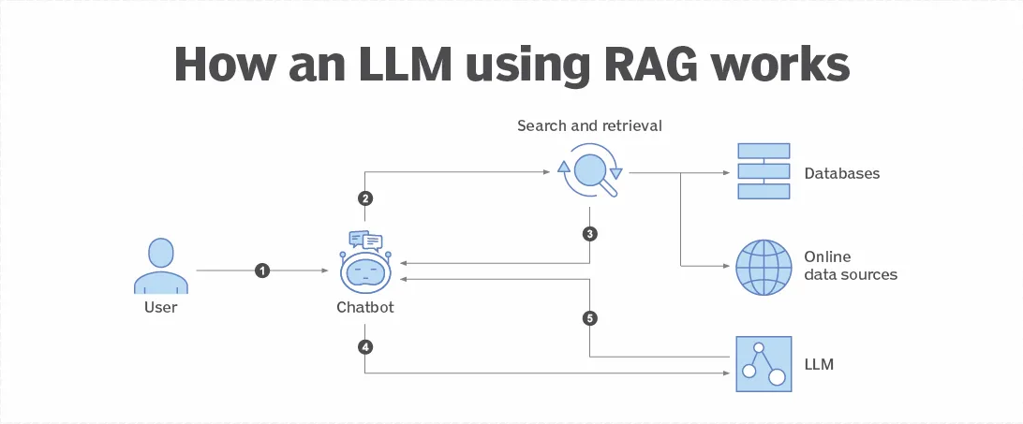
Retrieval-Augmented Generation（RAG）

Slide 14
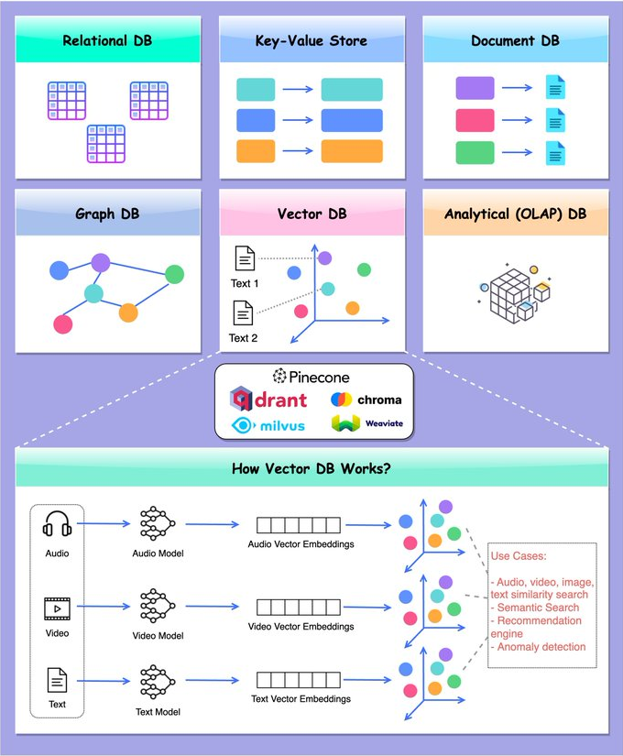
Database & Indexing

Slide 15
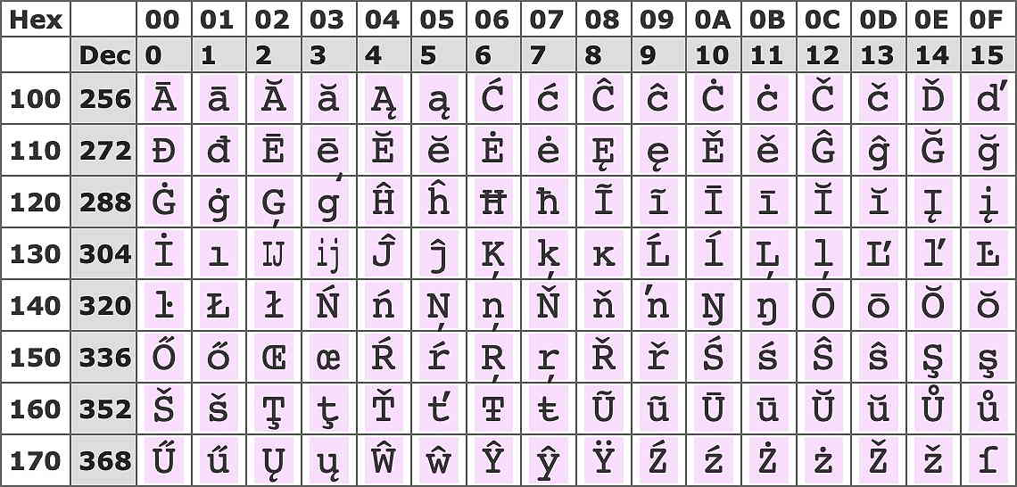

Encoding
Assign a unique code to each word
Unicode
How to encode relationships
Feature-based encoding
 | creatures | plush | woof | meow | walk upright | intelligent
Cat | 1 | 1 | 0 | 1 | 0 | 0
Dog | 1 | 1 | 1 | 0 | 0 | 0
Man | 1 | 0 | 0 | 0 | 1 | 1
Android | 0 | 0 | 0 | 0 | 1 | 1

Slide 16
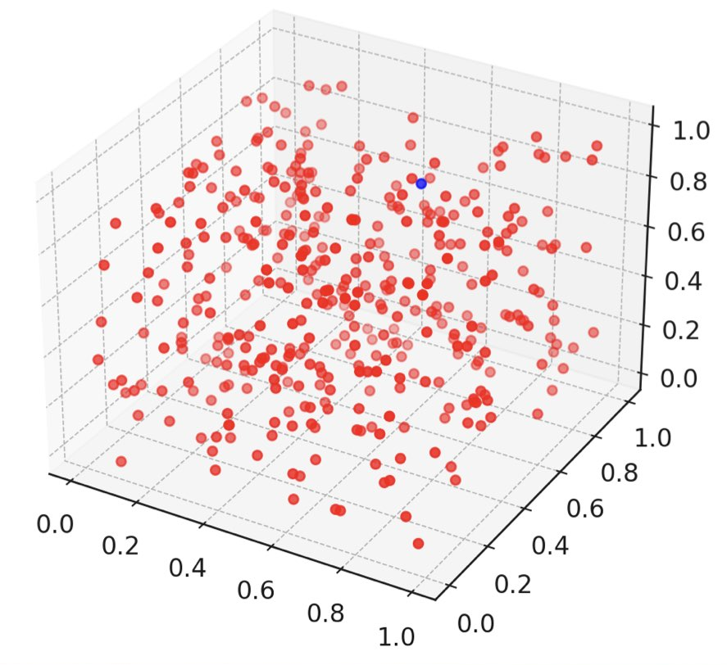
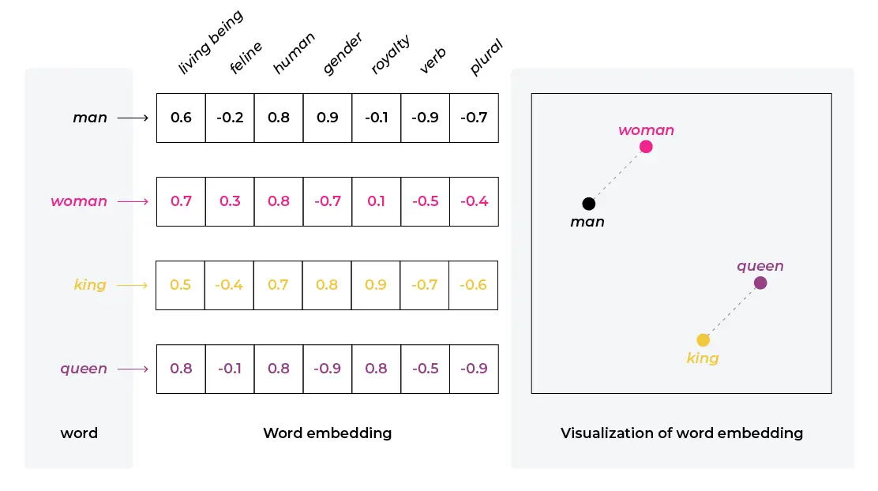
Embedding
Impossible to define artificially
Obtained through machine learning

Slide 17
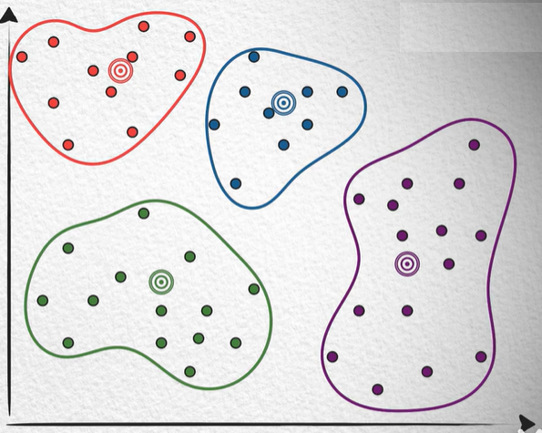
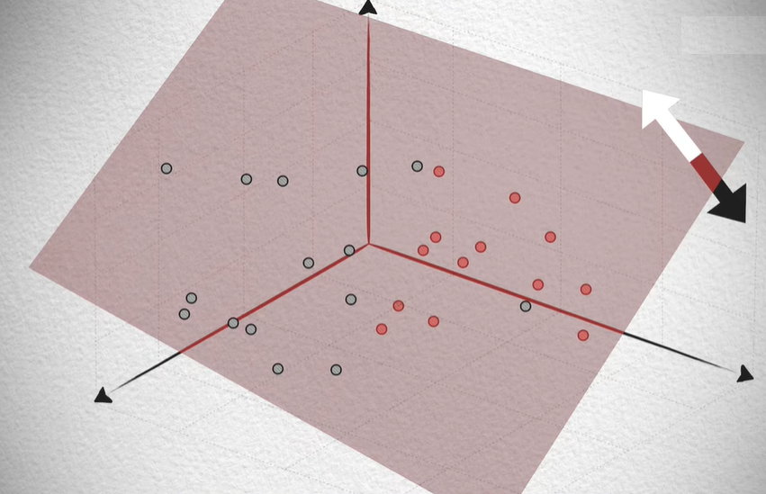
Vector Database
Quickly retrieve similar vectors
How to compare vector similarities？
Cosine similarity
Euclidean distance
Related algorithm
Clustering
Locality Sensitive Hashing + Segmentation
Quantization
Fast Approximate Nearest Neighbors Search
Notes:
https://www.bilibili.com/video/BV11a4y1c7SW/?spm_id_from=333.999.0.0&vd_source=15382cb163db3fd3ce2d2dd6b97e422a
https://www.bilibili.com/video/BV1BM4y177Dk/?spm_id_from=333.999.0.0&vd_source=15382cb163db3fd3ce2d2dd6b97e422a

